Slide 1



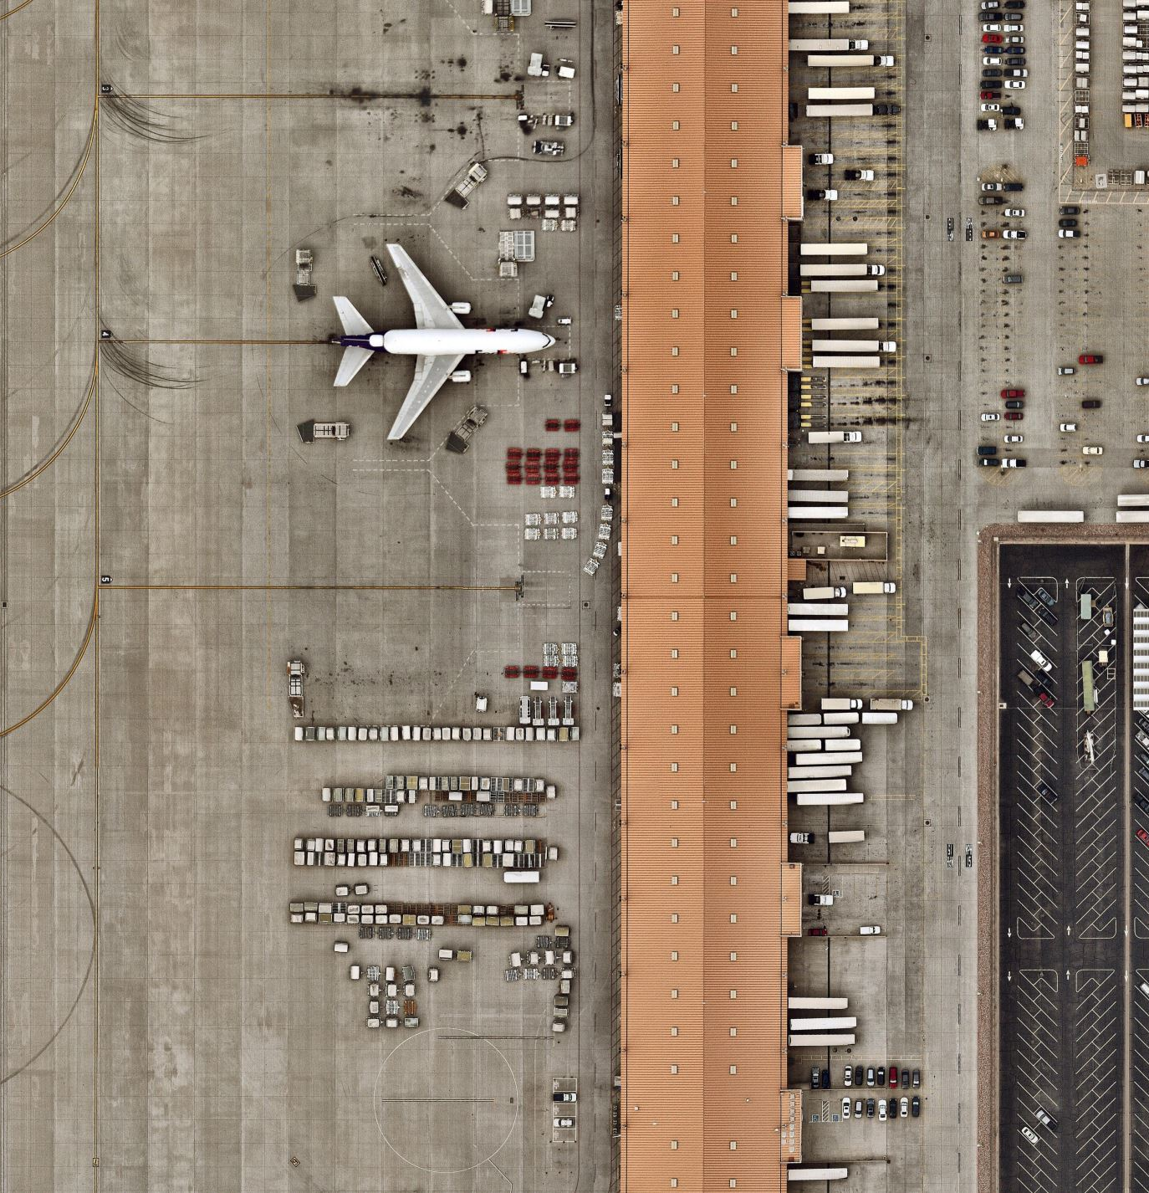
Online flight ticket booking system

Slide 2

Content
INTRODUCTION
FEATURES OF OUR PROPOSED SYSTEM
HIERARCHY OF FLIGHT BOOKING SYSTEM
UI DESIGN OF TARGET SYSTEM
COMPONENTS FOR CREATING A WEBSITE
HOW IS THE PROCESS PHOENIX WEBSITE?

Slide 3

INTRODUCTION
This is a web-based application to manage Airline Service Process of Phoenix Airline PVT.
Previously they have manual-based system.
Because of covid-19 they cannot do them manually. So, they required a website for that.
Basically, they need to fulfil 3 main processes.
1. user management
2. flight management
3. and ticket management
Notes:
Bhagya

Slide 4

WHAT ARE THE FEATURES?
We decided to provide 2 main features from our proposed system.
1. User account creation
2. Ticket booking process
Notes:
bhagya

Slide 5
Online Flight Booking System
User Dashboard
Staff Dashboard
Admin Dashboard
Staff 01
Staff 02
Information
Flight
Ticketing
Information
Flight
Dashboard
Staff
Settings
User
User account
Register
Log in
Profile
Bookings
Previous Bookings
Requests
Bookings
Destinations
Type of Trip
Class
Notes:
bhagya

Slide 6


UI DESIGN
of
Target system

Slide 7
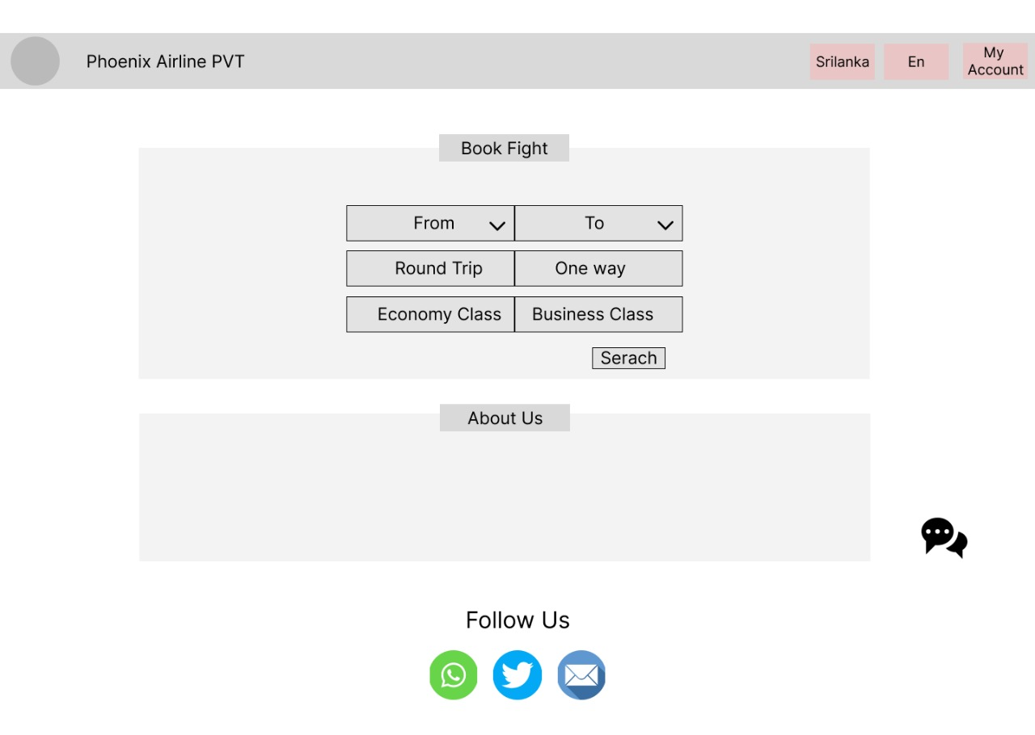
USER DASHBORD &
HOME PAGE
Notes:
bupendra

Slide 8
Notes:
bupendra

Slide 9
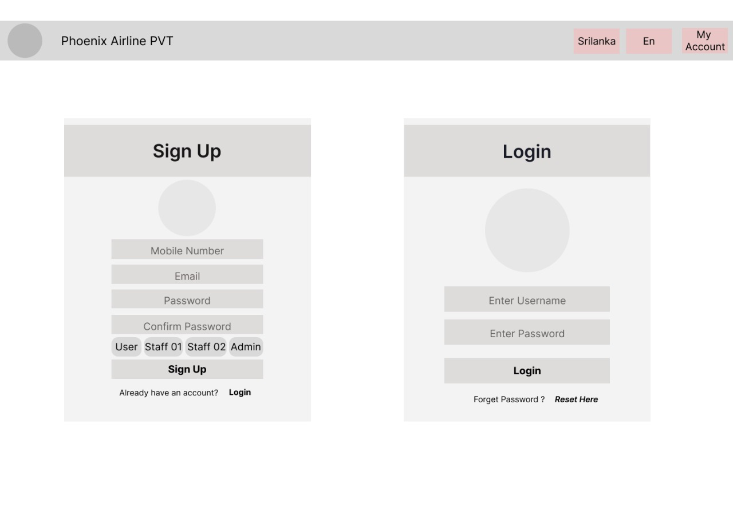
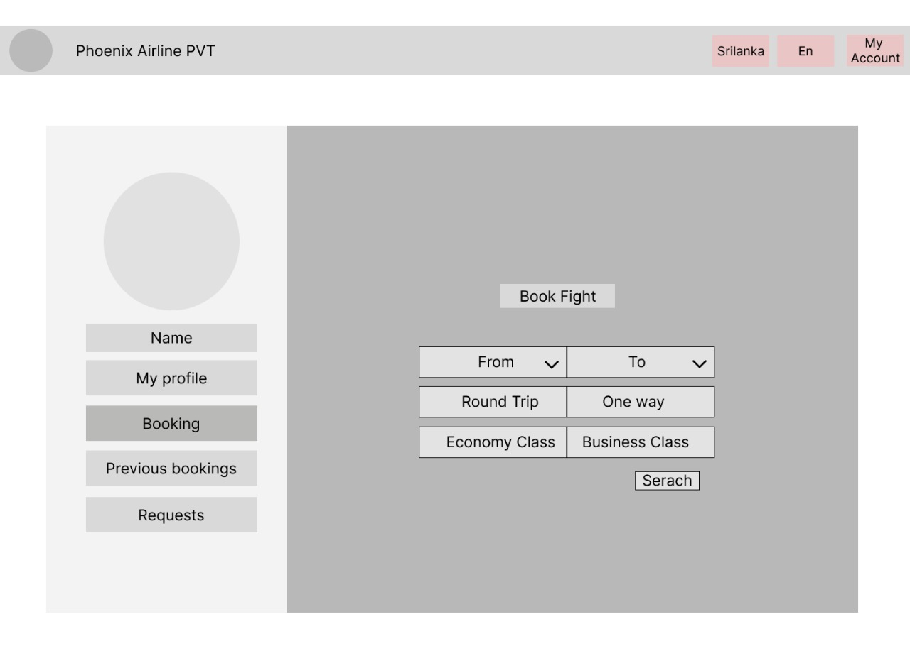
MY ACCOUNT
Notes:
yasas

Slide 10
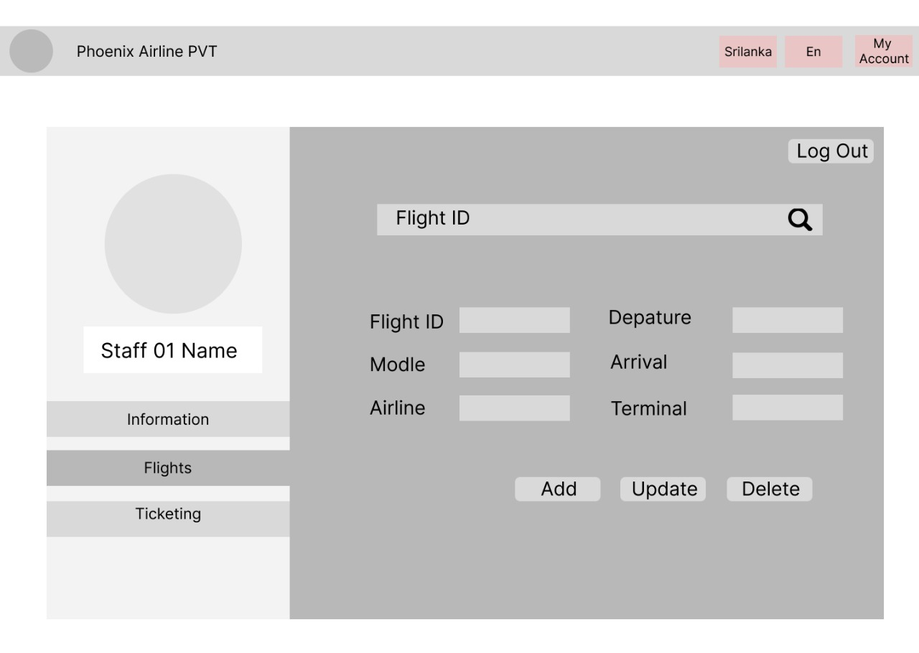
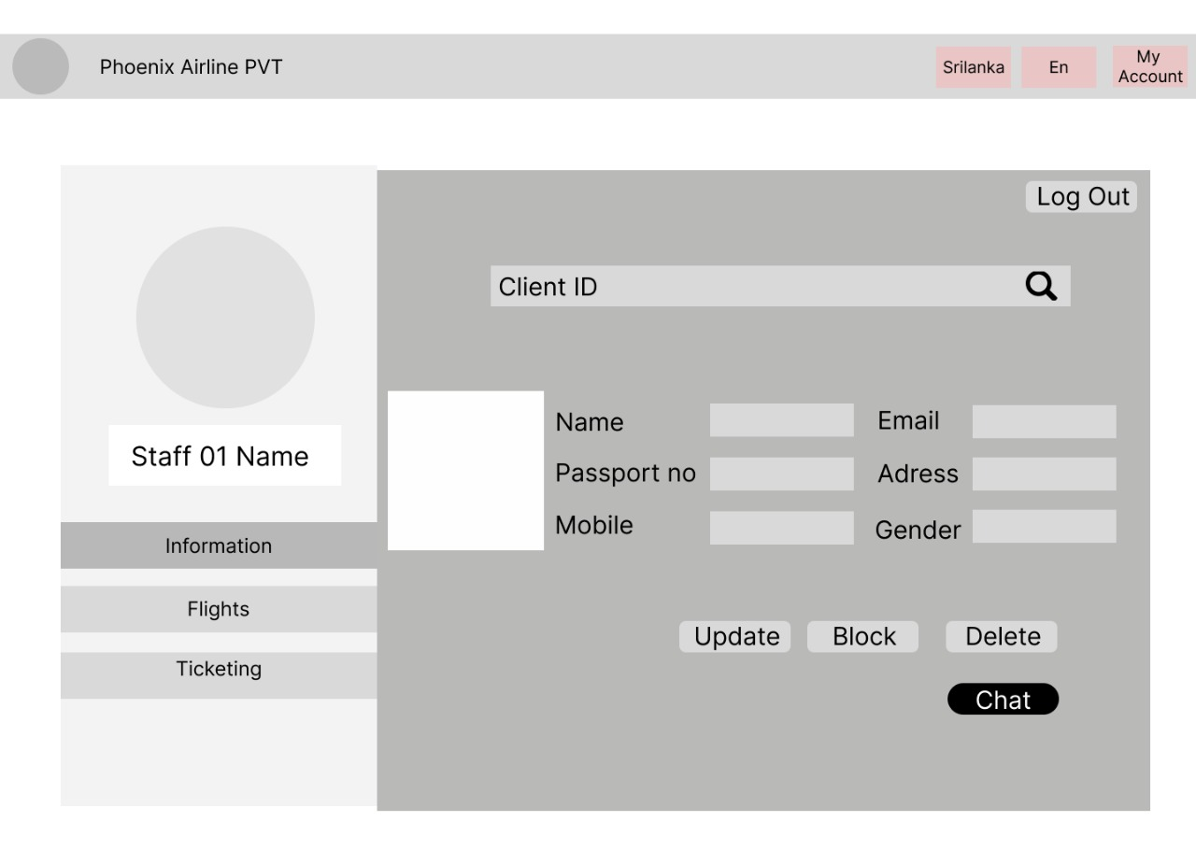
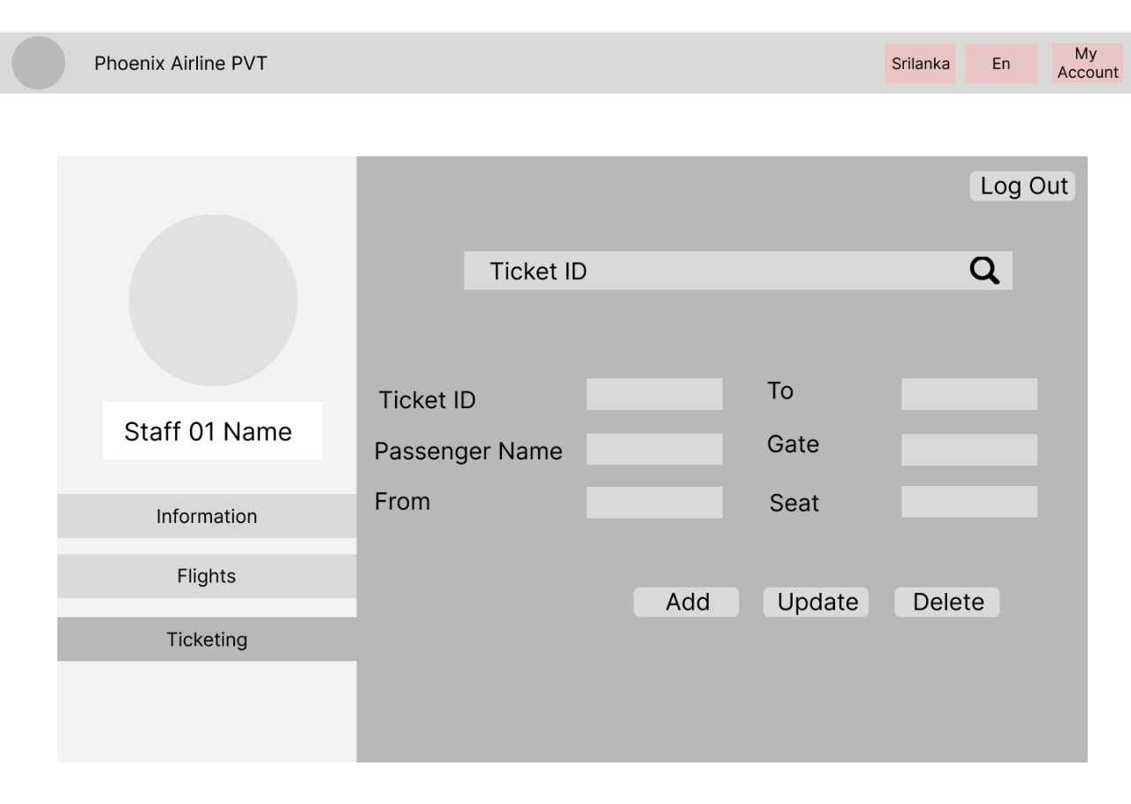
STAFF 01
DASHBOARD
Notes:
yasas

Slide 11
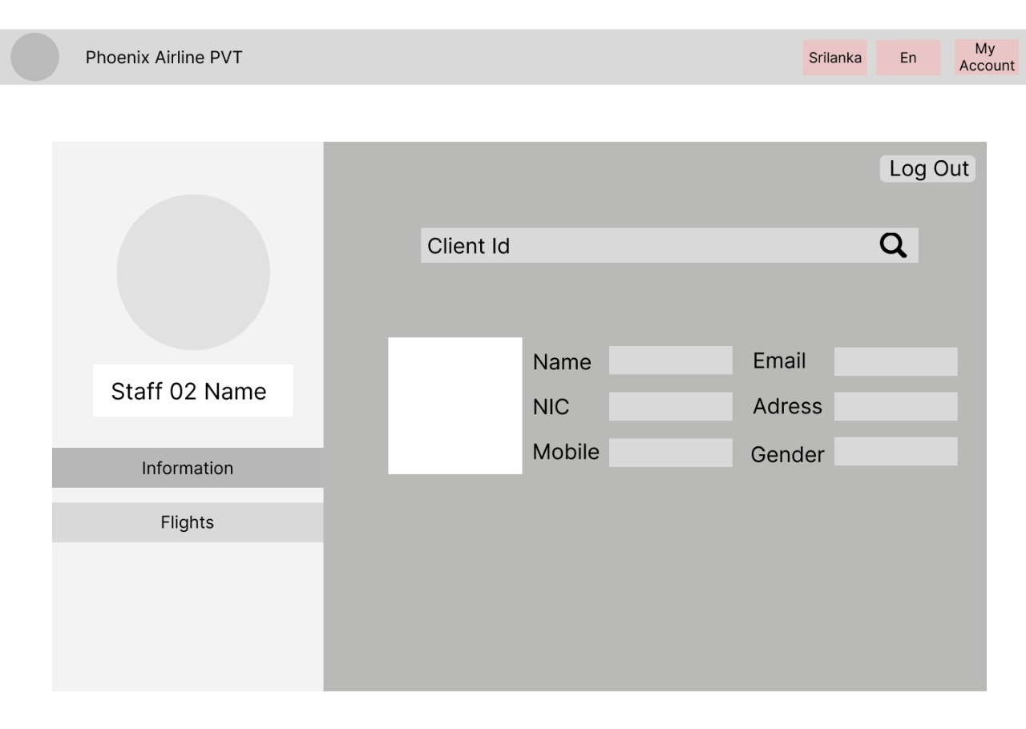
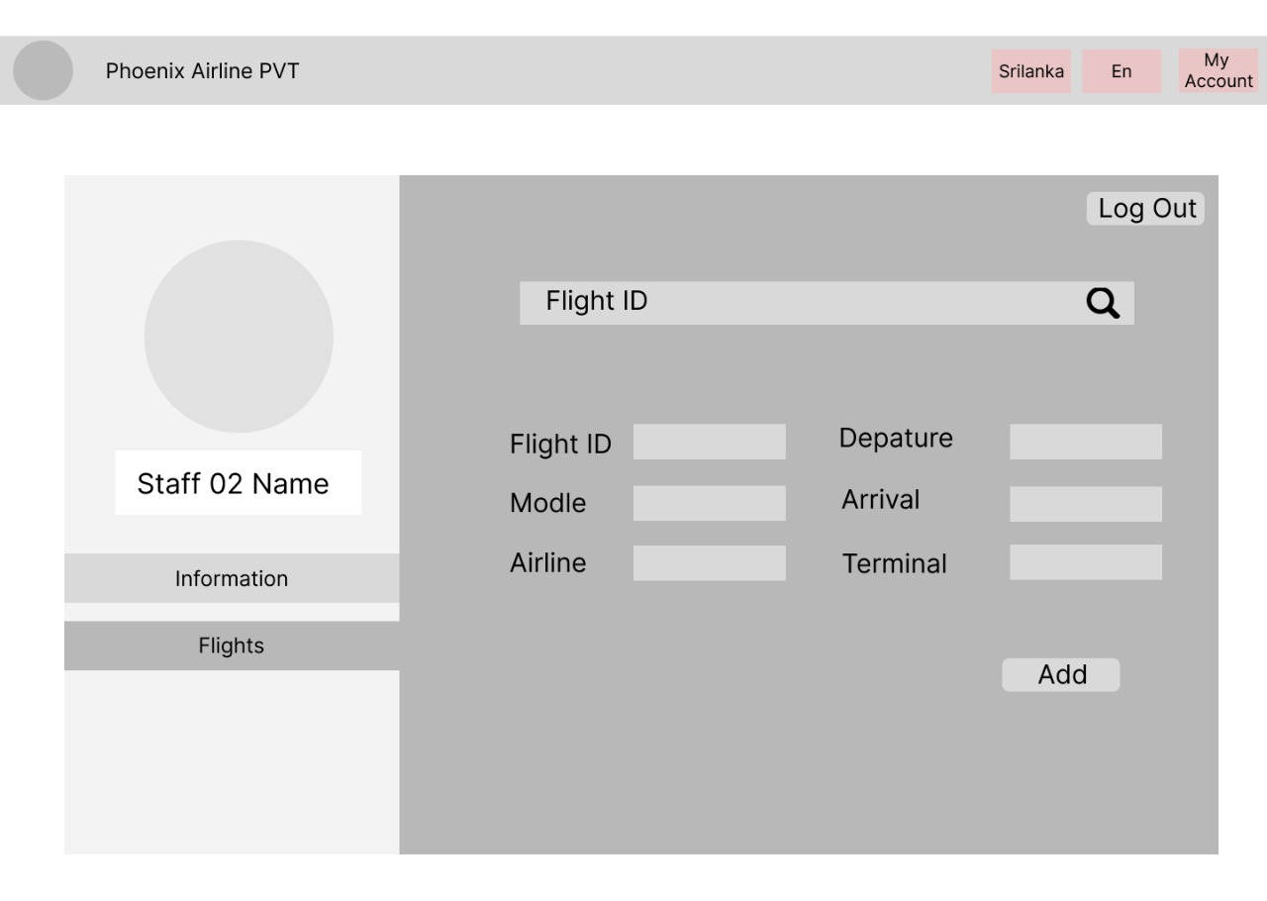
STAFF 02
DASHBOARD
Notes:
nimsara

Slide 12
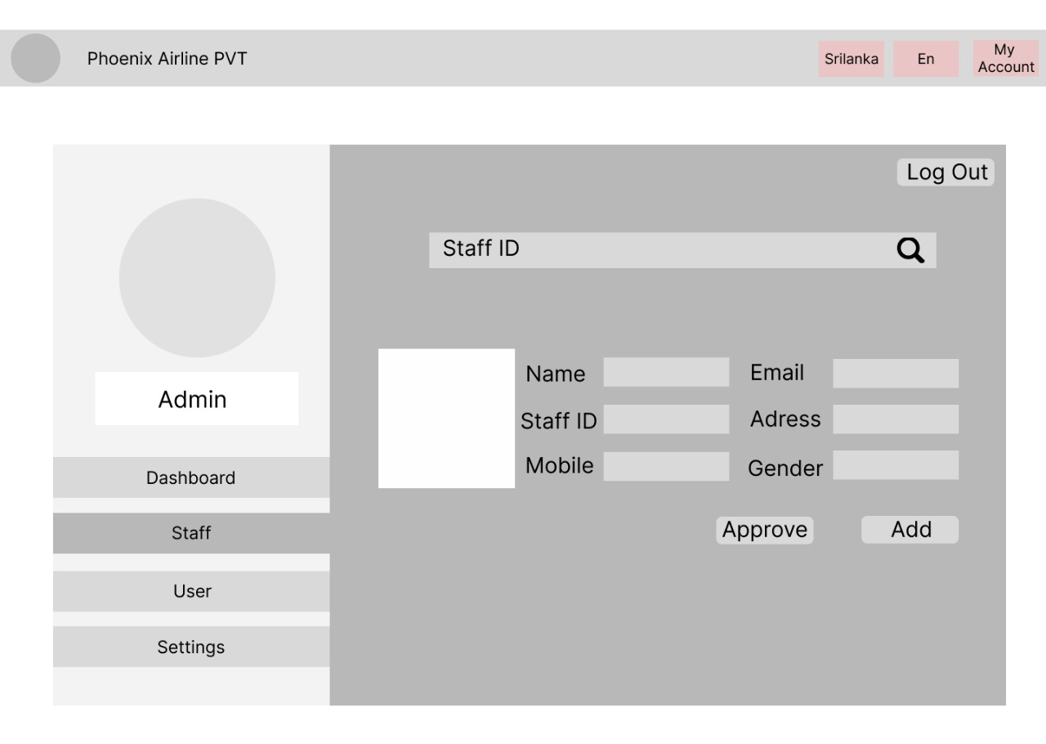
ADMIN
DASHBOARD
Notes:
nimsara

Slide 13







WHAT WE USE TO CREATE WEBSITE?
We are planning to use HTML, CSS, JAVASCRIPT, PHP and JAVA as our coding languages.
Visual Studio (VS) Code and NetBeans IDE for coding.
Use XAMPP as cross-platform web servers and use MySQL as language.
Notes:
tharusha

Slide 14
HOW THE PROCESS WORKS
Step 01
Gathering required information and designing UI (user interface)
Step 02
Developing website according to UI using HTML, CSS and JS.
Step 03
Creating a database by using XAMPP as cross-platform web servers and MySQL as a Language.
Step 04
connecting Web site and database by using JAVA.
Step 05
Hosting Website via GitHub.
?
Notes:
amasha

Slide 15
Thank you.
Members | Index No:
R B Wickramarathne | 22691
G Y Y Mihiranga | 22684
K W C N B Kobbekaduwa | 22724
A L A Sewwandi | 22755
B D D Wijegunawardhana | 22712
E G T D EGODAGE | 22717

